Slide 1
RL algorithms analysis
Yue Wang
2017.3.16

Slide 2
Content
Basic notation
Evaluation problem
Objective function
Optimization techniques
Extend to off-policy and eligibility trace
Paper
Control problem
relationship and difference between control and evaluation problem
paper

Slide 3
Content
eligibility trace
Convergence rate analysis(finite sample analysis)
Evaluation problem
Control problem
Last week discussion problem
Off policy and importance sampling
MSE and MSBE bound

Slide 4
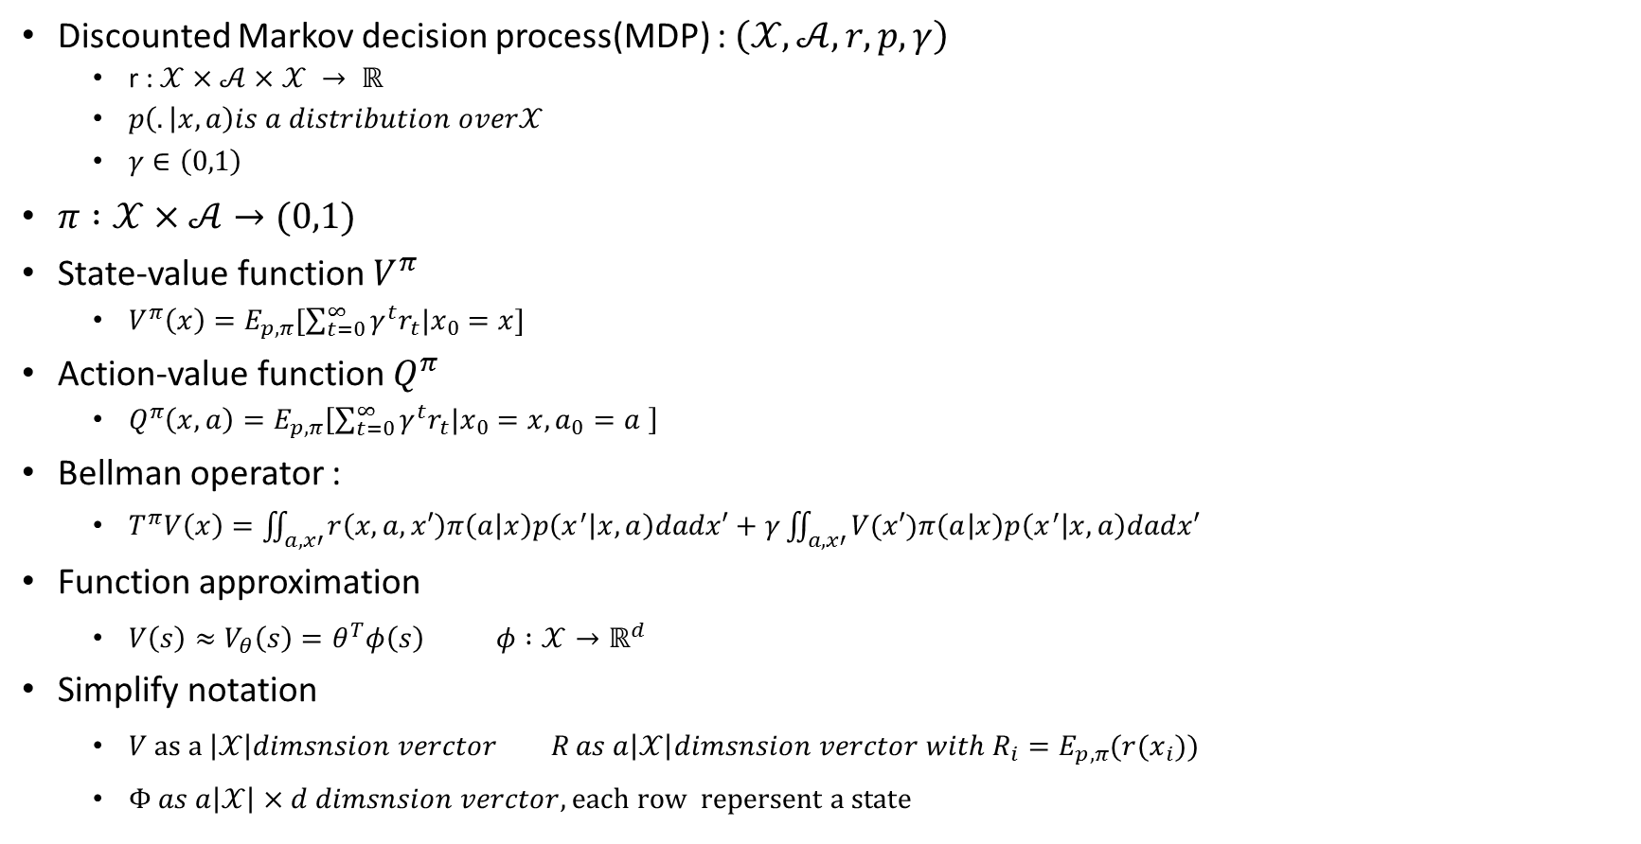
Basic notation
Discounted Markov decision process(MDP) : $\left(𝒳,𝒜,r,p,γ\right)$
r : $𝒳×𝒜×𝒳 → ℝ$
$p\left(. | x,a\right)is a distribution over𝒳$
$γ∈\left(0,1\right)$
$π :𝒳×𝒜→(0,1)$
State-value function $V^{π}$
$V^{π}\left(x\right)=E_{p,π}[\sum_{t=0}^{∞}{γ^{t}r_{t}|x_{0}=x}]$
Action-value function $Q^{π}$
$Q^{π}\left(x,a\right)=E_{p,π}\left[\sum_{t=0}^{∞}{γ^{t}r_{t}|x_{0}=x,a_{0}=a }\right]$
Bellman operator :
$T^{π}V\left(x\right)=\iint_{a,x′}{r\left(x,a,x′\right)π\left(a | x\right)p\left(x^{′} | x,a\right)dadx′}+γ\iint_{a,x′}{V(x′)π\left(a | x\right)p\left(x^{′} | x,a\right)dadx′}$
Function approximation
$V\left(s\right)≈V_{θ}\left(s\right)=θ^{T}φ\left(s\right) φ :𝒳→ℝ^{d}$
Simplify notation
$V as a \left|𝒳\right|dimsnsion verctor R as a\left|𝒳\right|dimsnsion verctor with R_{i}=E_{p,π}(r(x_{i}))$
$Φ as a\left|𝒳\right|×d dimsnsion verctor, each row repersent a state$

Slide 5
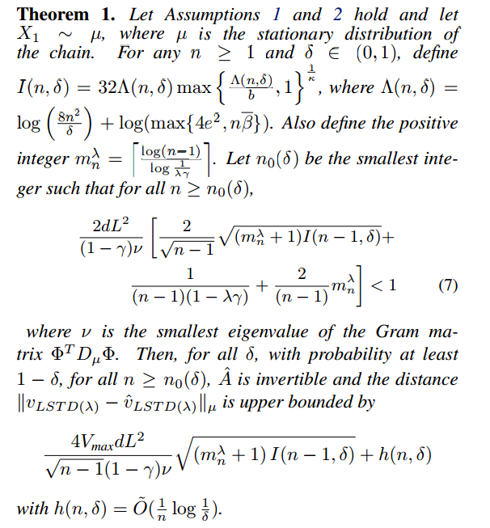

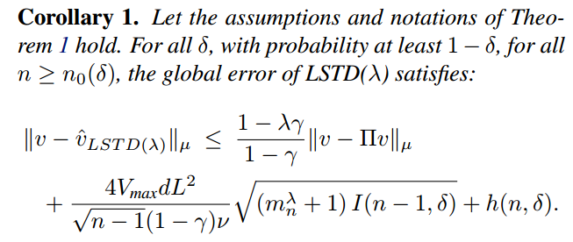


On the rate of convergence and error bounds for LSTD($λ$) 2015 ICML
On-policy, policy evolution, LSTD($λ$)
Theorem :

Slide 6

On the rate of convergence and error bounds for LSTD($λ$) 2015 ICML
On-policy, policy evolution, LSTD($λ$)
Future work:
Extend to policy iteration scheme
LSTD($λ$) for off-policy

Slide 7
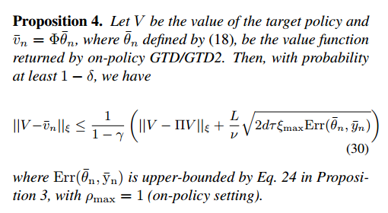
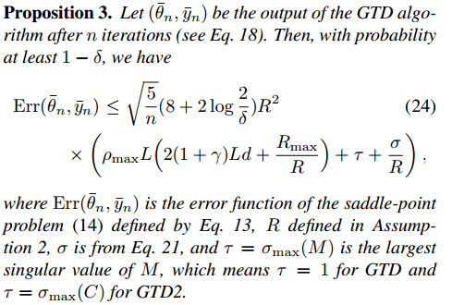
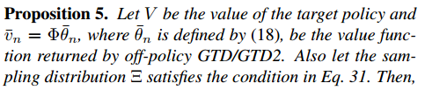
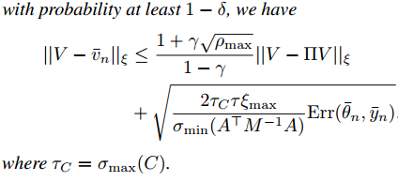
Finite-Sample Analysis of Proximal Gradient TD Algorithms 2015 UAL
On/Off-policy, policy evolution, GTD

Slide 8
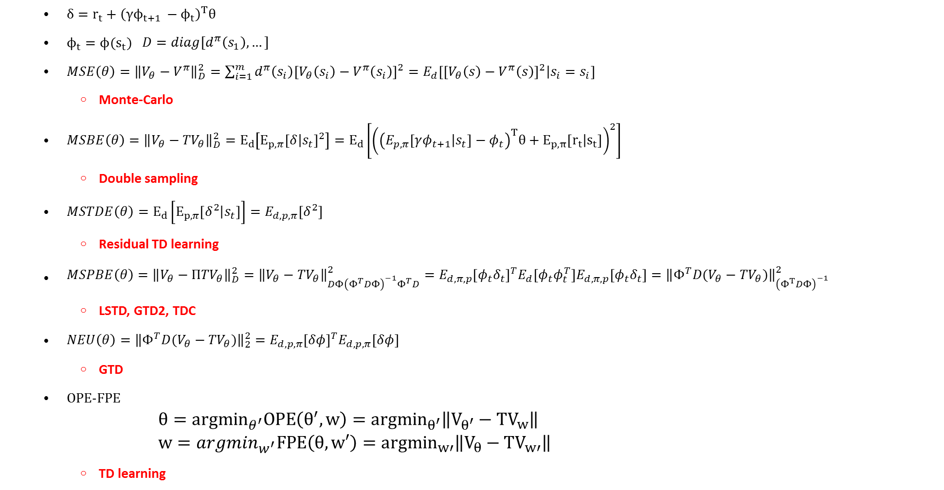
Objective function
$δ=r_{t}+{\left(γϕ_{t+1 }−ϕ_{t}\right)}^{T}θ$
$ϕ_{t}=ϕ(s_{t})$ $D=diag[d^{π}\left(s_{1}\right),…]$
$MSE\left(θ\right)={\left\|V_{θ}−V^{π}\right\|}_{D}^{2}=\sum_{i=1}^{m}{d^{π}\left(s_{i}\right){\left[V_{θ}\left(s_{i}\right)−V^{π}\left(s_{i}\right)\right]}^{2}=E_{d}\left[{\left[V_{θ}\left(s\right)−V^{π}\left(s\right)\right]}^{2} | s_{i}=s_{i}\right]}$
Monte-Carlo
$MSBE\left(θ\right)={\left\|V_{θ}−{TV}_{θ}\right\|}_{D}^{2}=E_{d}\left[E_{p,π}{\left[δ | s_{t}\right]}^{2}\right]=E_{d}\left[{\left({\left(E_{p,π}\left[γφ_{t+1} | s_{t}\right]−φ_{t}\right)}^{T}θ+E_{p,π}\left[r_{t} | s_{t}\right]\right)}^{2}\right]$
Double sampling
$MSTDE\left(θ\right)=E_{d}\left[E_{p,π}\left[δ^{2} | s_{t}\right]\right]=E_{d,p,π}\left[δ^{2}\right]$
Residual TD learning
$MSPBE\left(θ\right)={\left\|V_{θ}−{ΠTV}_{θ}\right\|}_{D}^{2}={\left\|V_{θ}−{TV}_{θ}\right\|}_{DΦ{\left(Φ^{T}DΦ\right)}^{−1}Φ^{T}D}^{2}=E_{d,π,p}{\left[φ_{t}δ_{t}\right]}^{T}E_{d}\left[φ_{t}φ_{t}^{T}\right]E_{d,π,p}\left[φ_{t}δ_{t}\right]={\left\|Φ^{T}D(V_{θ}−{TV}_{θ})\right\|}_{{\left(Φ^{T}DΦ\right)}^{−1}}^{2}$
LSTD, GTD2, TDC
$NEU\left(θ\right)={\left\|{Φ^{T}D(V}_{θ}−{TV}_{θ})\right\|}_{2}^{2}=E_{d,p,π}{\left[δφ\right]}^{T}E_{d,p,π}\left[δφ\right]$
GTD
OPE-FPE
$$θ={argmin}_{θ^{′}}OPE\left(θ^{′},w\right)={argmin}_{θ^{′}}\left\|V_{θ^{′}}−{TV}_{w}\right\|$$
$$w=argmin_{w^{′}}FPE\left(θ,w′\right)={argmin}_{w′}\left\|V_{θ}−{TV}_{w′}\right\|$$
TD learning

Slide 9


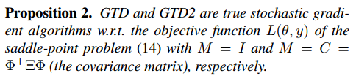
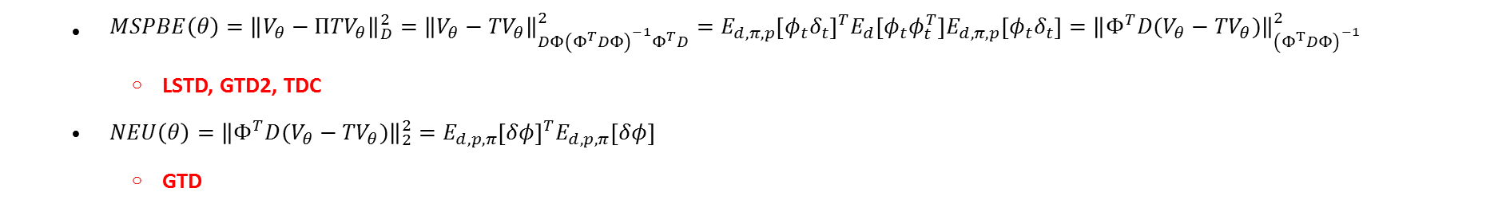
Finite-Sample Analysis of Proximal Gradient TD Algorithms
$MSPBE\left(θ\right)={\left\|V_{θ}−{ΠTV}_{θ}\right\|}_{D}^{2}={\left\|V_{θ}−{TV}_{θ}\right\|}_{DΦ{\left(Φ^{T}DΦ\right)}^{−1}Φ^{T}D}^{2}=E_{d,π,p}{\left[φ_{t}δ_{t}\right]}^{T}E_{d}\left[φ_{t}φ_{t}^{T}\right]E_{d,π,p}\left[φ_{t}δ_{t}\right]={\left\|Φ^{T}D(V_{θ}−{TV}_{θ})\right\|}_{{\left(Φ^{T}DΦ\right)}^{−1}}^{2}$
LSTD, GTD2, TDC
$NEU\left(θ\right)={\left\|{Φ^{T}D(V}_{θ}−{TV}_{θ})\right\|}_{2}^{2}=E_{d,p,π}{\left[δφ\right]}^{T}E_{d,p,π}\left[δφ\right]$
GTD
$J\left(θ\right)={\left\|Φ^{T}D\left(V_{θ}−TV_{θ}\right)\right\|}_{M^{−1}}^{2}={\left\|E[ρ_{t}δ_{t}φ_{t}]\right\|}_{M^{−1}}^{2} M=I for GTD M=Φ^{T}DΦ for GTD2$

Slide 10
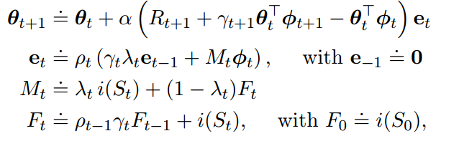
An emphatic approach to the problem of off-policy temporal-difference learning 2016 JMLR
Off-policy, policy evolution,
Future work:
Extend to control setting
Extend to weighted importance sampling
Extend to action-value function

Slide 11
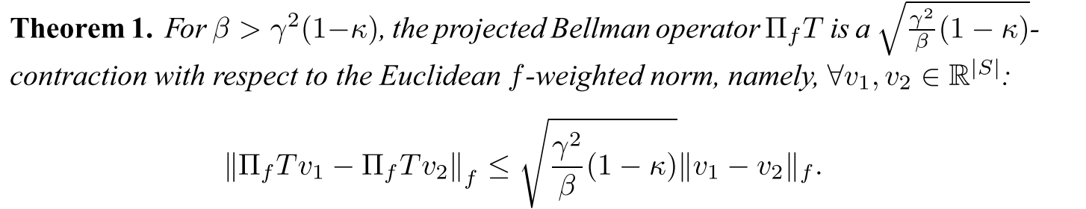
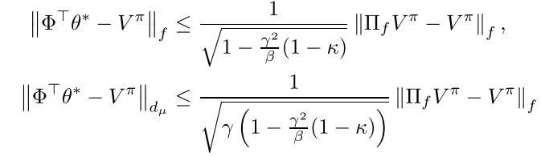

Generalized Emphatic Temporal Difference Learning: Bias-Variance Analysis 2016 AAAI
Off-policy, policy evolution, ETD
ETD$\left(0,β\right)$: $θ_{t+1}=θ_{t}+αF_{t}ρ_{t}\left(r_{t+1}+γθ_{t}^{T}φ_{t+1}−θ_{t}^{T}φ_{t}\right)φ_{t}$
$F_{t}=βρ_{t−1}F_{t−1}+1$
Define : $f=d_{μ}+βP_{π}^{T}d_{μ}+{\left(βP_{π}^{T}\right)}^{2}d_{μ}+…={\left(I−βP_{π}^{T}\right)}^{−1}d_{μ}$ $κ=\min_{s}\frac{d_{μ}(s)}{f(s)} ∈\left[0,1−β\right]$
$⁡$
Bias analysis:

Slide 12
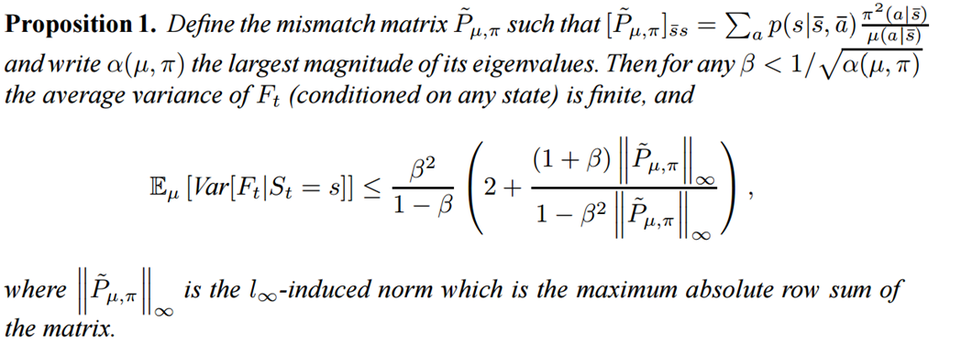

Generalized Emphatic Temporal Difference Learning: Bias-Variance Analysis 2016 AAAI
Off-policy, policy evolution, ETD
ETD$\left(0,β\right)$: $θ_{t+1}=θ_{t}+αF_{t}ρ_{t}\left(r_{t+1}+γθ_{t}^{T}φ_{t+1}−θ_{t}^{T}φ_{t}\right)φ_{t}$
$F_{t}=βρ_{t−1}F_{t−1}+1$
Define : $f=d_{μ}+βP_{π}^{T}d_{μ}+{\left(βP_{π}^{T}\right)}^{2}d_{μ}+…={\left(I−βP_{π}^{T}\right)}^{−1}d_{μ}$ $κ=\min_{s}\frac{d_{μ}(s)}{f(s)} ∈\left[0,1−β\right]$
Variance analysis :

Slide 13
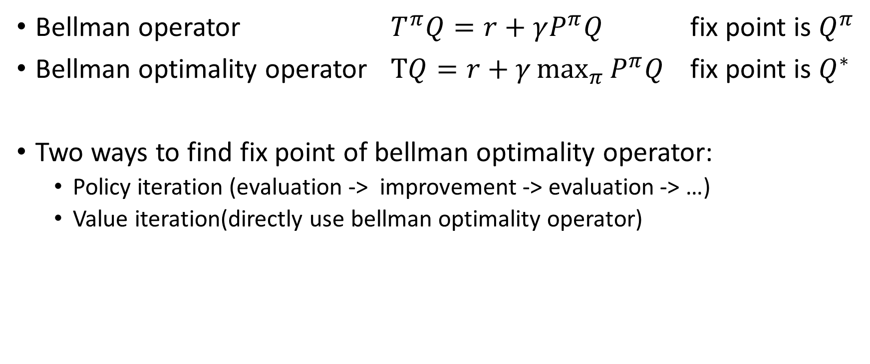
Control problem
Bellman operator $T^{π}Q=r+γP^{π}Q$ fix point is $Q^{π}$
Bellman optimality operator $TQ=r+γ\max_{π}{P^{π}Q}$ fix point is $Q^{∗}$
Two ways to find fix point of bellman optimality operator:
Policy iteration (evaluation -> improvement -> evaluation -> …)
Value iteration(directly use bellman optimality operator)

Slide 14
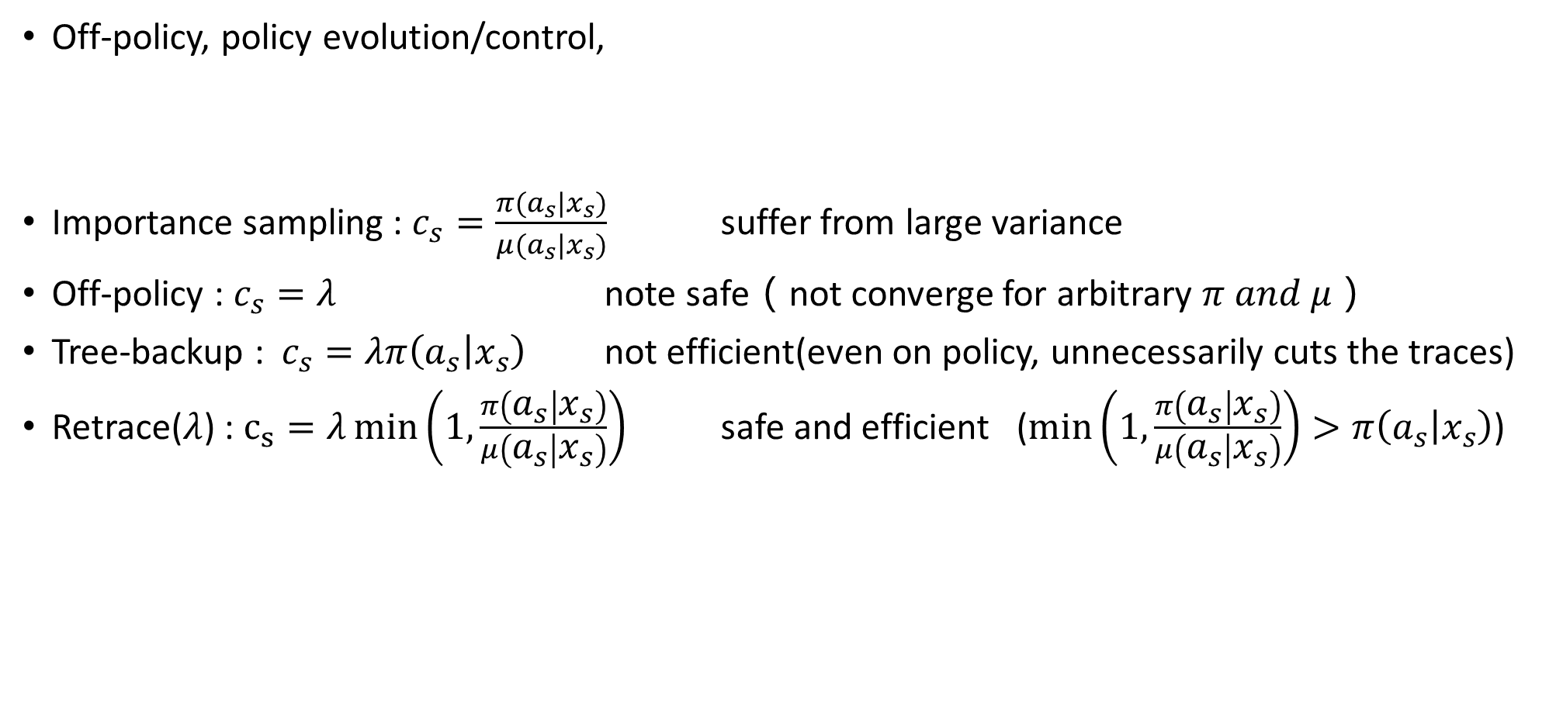
Safe and efficient off-policy reinforcement learning 2016 NIPS
Off-policy, policy evolution/control,
Importance sampling : $c_{s}=\frac{π(a_{s}|x_{s})}{μ(a_{s}|x_{s})}$ suffer from large variance
Off-policy : $c_{s}=λ$ note safe（not converge for arbitrary $π and μ$）
Tree-backup : $c_{s}=λπ\left(a_{s} | x_{s}\right)$ not efficient(even on policy, unnecessarily cuts the traces)
Retrace($λ$) : $c_{s}=λ\min\left(1,\frac{π\left(a_{s} | x_{s}\right)}{μ\left(a_{s} | x_{s}\right)}\right)$ safe and efficient ($\min\left(1,\frac{π\left(a_{s} | x_{s}\right)}{μ\left(a_{s} | x_{s}\right)}\right)>π\left(a_{s} | x_{s}\right)$)

Slide 15
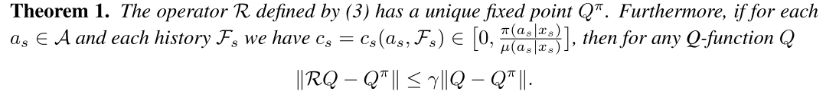
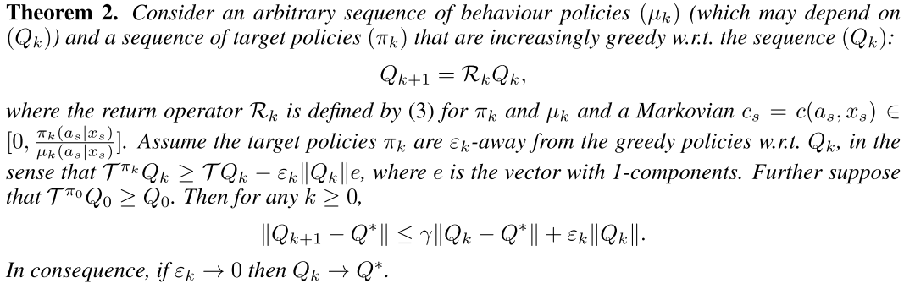
Safe and efficient off-policy reinforcement learning 2016 NIPS

Slide 16
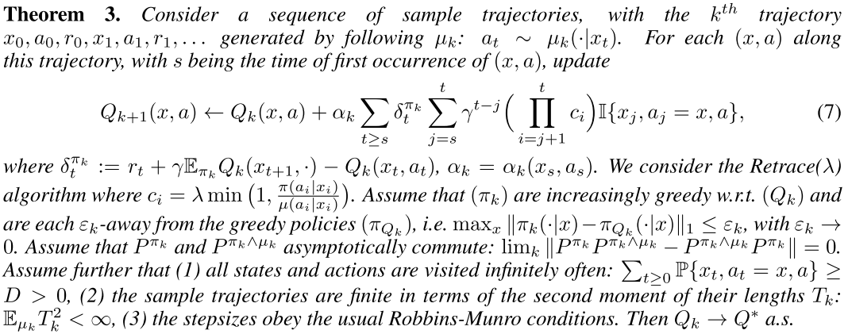
Safe and efficient off-policy reinforcement learning 2016 NIPS

Slide 17
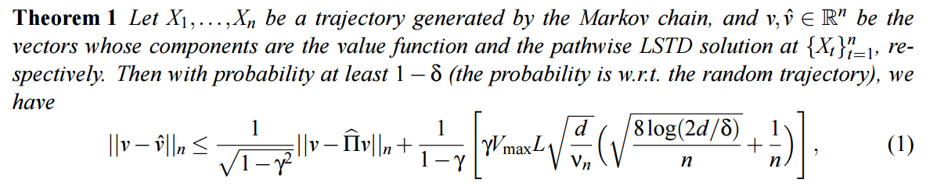
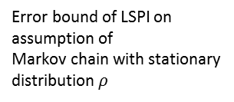
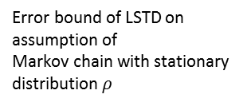
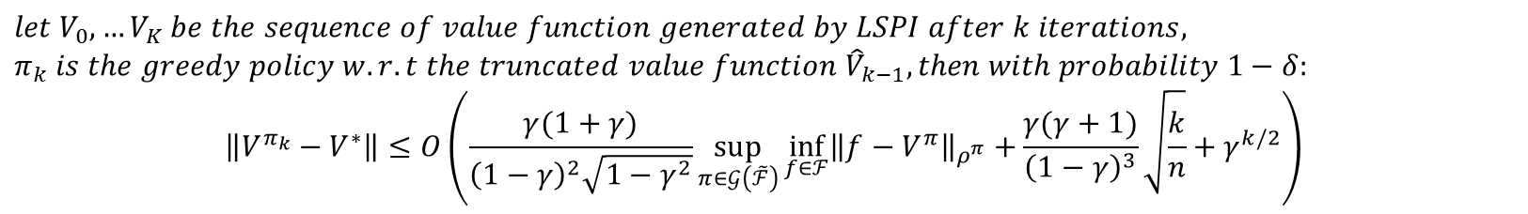
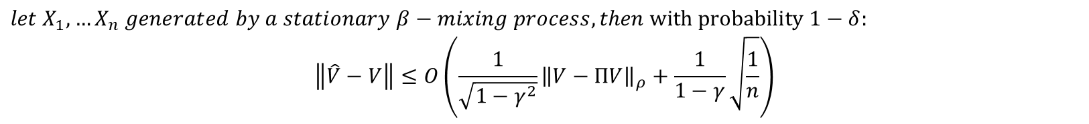
Finite-sample analysis of least-squares policy iteration JMLR2012
the performance is evaluated only at the states visited by the Markov chain and no generalization on other states is possible
Error bound of LSTD on assumption of
Markov chain
Uniqueness of LSTD solution
$$if n>n_{0}\left(δ\right), then with probability 1−δ:$$
$$the family of features is linearly independent and the smallest eigenvalue of Φ^{T}Φ>0$$
$$let X_{1},…X_{n} generated by a stationary β−mixing process, then with probability 1−δ:$$
$$\left\|\hat{V}−V\right\|≤O\left(\frac{1}{\sqrt{1−γ^{2}}}{\left\|V−ΠV\right\|}_{ρ}+\frac{1}{1−γ}\sqrt{\frac{1}{n}}\right)$$
Error bound of LSTD on assumption of
Markov chain with stationary distribution $ρ$
$$let V_{0},…V_{K} be the sequence of value function generated by LSPI after k iterations,$$
$$π_{k} is the greedy policy w.r.t the truncated value function {\hat{V}}_{k−1}, then with probability 1−δ:$$
$$\left\|V^{π_{k}}−V^{∗}\right\|≤O\left(\frac{γ(1+γ)}{{\left(1−γ\right)}^{2}\sqrt{1−γ^{2}}}\sup_{π∈𝒢\left(\tilde{ℱ}\right)}{\inf_{f∈ℱ}{{\left\|f−V^{π}\right\|}_{ρ^{π}}+}}\frac{γ(γ+1)}{{\left(1−γ\right)}^{3}}\sqrt{\frac{k}{n}}+γ^{k/2}\right)$$
Error bound of LSPI on assumption of
Markov chain with stationary distribution $ρ$
Farahmand, Amir-massoud, Csaba Szepesvári, and Rémi Munos. "Error propagation for approximate policy and value iteration." Advances in Neural Information Processing Systems. 2010.

Slide 18
Last week discussion problem
Off policy and importance sampling

Slide 19
Paper relate to importance sampling
Importance sampling
Weighted importance sampling
Table
Off policy temporal difference learning with function approximation(2001 ICML)
Function approximation
LS
Weighted importance sampling for off policy learning with linear function approximation (2014 NIPS)
O(n)
Off policy learning based on weighted importance sampling with linear computational complexity(2015 UAL)
No importance sampling
Table
(Tree backup) Eligibility Traces for Off-Policy Policy Evaluation(2000 ICML)
Q(\lambda) with off policy corrections(2016 International Conference on Algorithmic Learning Theory)
Function approximation
Multi-step off-policy learning without importance sampling ratios(2017 arxiv)

Slide 21
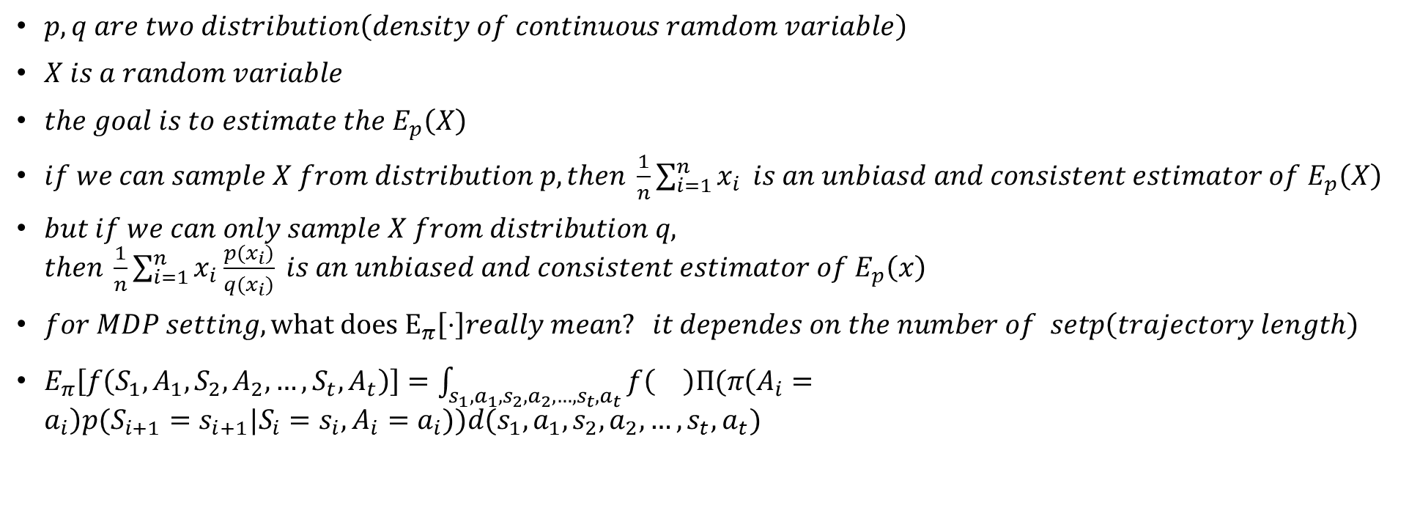
Importance sampling
$p,q are two distribution\left(density of continuous ramdom variable\right)$
$X is a random variable$
$the goal is to estimate the E_{p}\left(X\right)$
$if we can sample X from distribution p, then \frac{1}{n}\sum_{i=1}^{n}{x_{i}} is an unbiasd and consistent estimator of E_{p}\left(X\right)$
$but if we can only sample X from distribution q, then \frac{1}{n}\sum_{i=1}^{n}{x_{i}\frac{p(x_{i})}{q(x_{i})} is an unbiased and consistent estimator of E_{p}\left(x\right)}$
$for MDP setting, what does E_{π}\left[⋅\right]really mean? it dependes on the number of setp\left(trajectory length\right)$
$E_{π}\left[f\left(S_{1},A_{1},S_{2},A_{2},…,S_{t},A_{t}\right)\right]=\int_{s_{1},a_{1},s_{2},a_{2},…,s_{t},a_{t}}{f\left(\right)Π(π\left(A_{i}=a_{i}\right)p(S_{i+1}=s_{i+1}|S_{i}=s_{i},A_{i}=a_{i}))d(s_{1},a_{1},s_{2},a_{2},…,s_{t},a_{t})}$

Slide 22
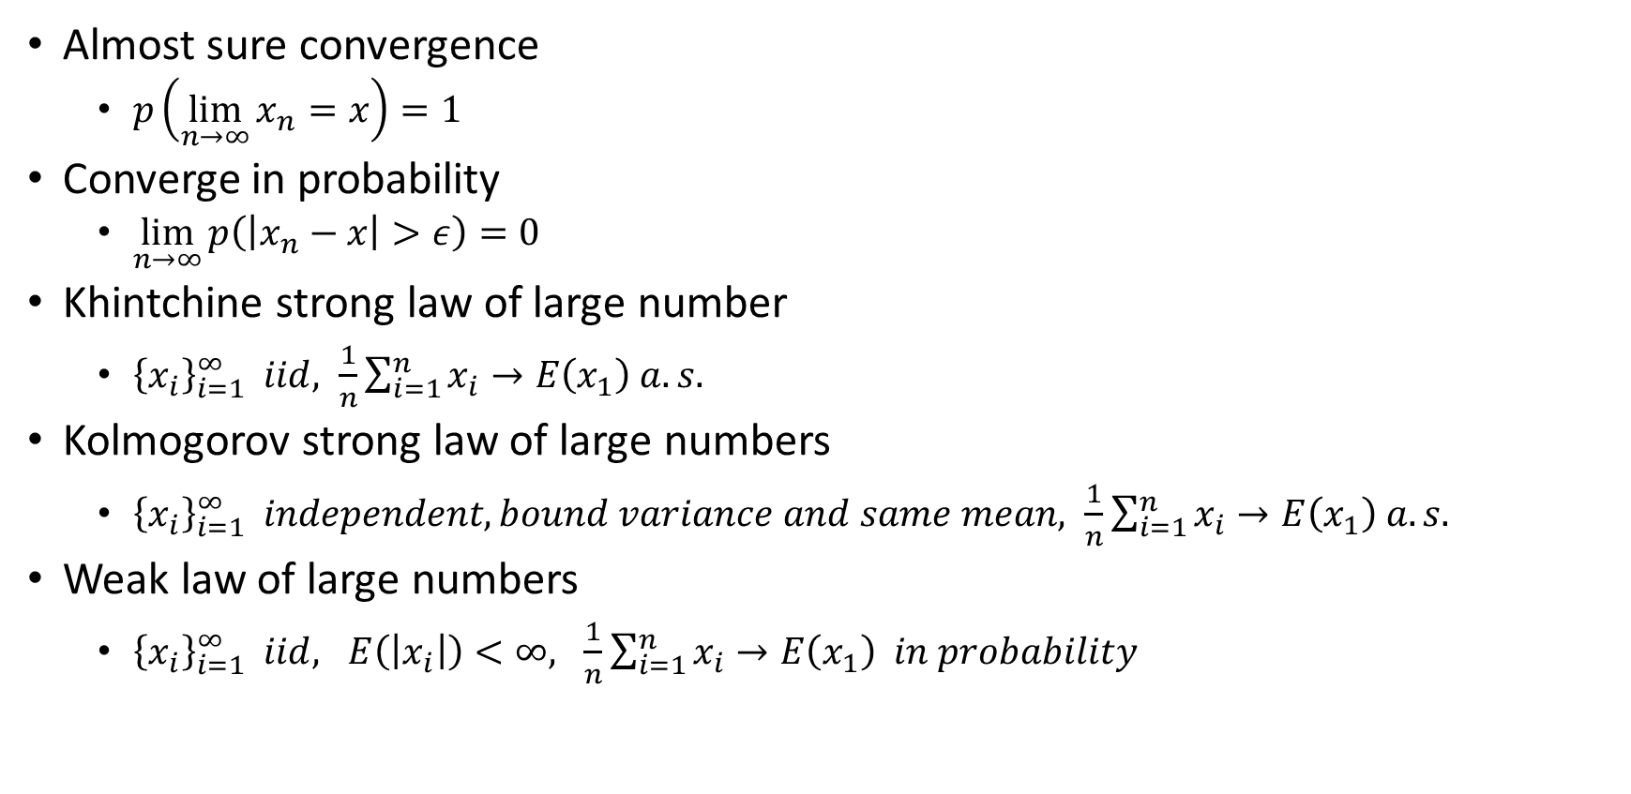
Some useful theorem
Almost sure convergence
$p\left(\lim_{n→∞}{x_{n}=x}\right)=1$
Converge in probability
$\lim_{n→∞}{p\left(\left|x_{n}−x\right|>ε\right)=0}$
Khintchine strong law of large number
${\left\{x_{i}\right\}}_{i=1}^{∞} iid, \frac{1}{n}\sum_{i=1}^{n}{x_{i}}→E\left(x_{1}\right) a.s.$
Kolmogorov strong law of large numbers
${\left\{x_{i}\right\}}_{i=1}^{∞} independent, bound variance and same mean, \frac{1}{n}\sum_{i=1}^{n}{x_{i}}→E\left(x_{1}\right) a.s.$
Weak law of large numbers
${\left\{x_{i}\right\}}_{i=1}^{∞} iid, E\left(\left|x_{i}\right|\right)<∞, \frac{1}{n}\sum_{i=1}^{n}{x_{i}}→E\left(x_{1}\right) in probability$

Slide 23

Importance sampling (for Monte carol method)
$Q_{N}^{IS}\left(s,a\right)=\frac{\sum_{i=1}^{N}{R_{i}w_{i}}}{N}$
Unbiased
$E_{b}\left[\frac{\sum_{i=1}^{N}{R_{i}w_{i}}}{N}\right]=E_{π}[\frac{\sum_{i=1}^{N}{R_{i}}}{N}]=Q^{π}(s,a)$
Consistent

Slide 24

Weighted importance sampling (for Monte carol method)
$Q_{N}^{WIS}\left(s,a\right)=\frac{\sum_{i=1}^{N}{R_{i}w_{i}}}{\sum_{i=1}^{N}{w_{i}}}$
Variance analysis
${var(Q}_{N}^{WIS})→0$
Proof : convergence a.s. imply variance $→ 0$
Biased
Consistent

Slide 25

Importance sampling
Off policy learning ($π_{b}≠π_{g}$)
Importance sampling
Weighted IS
Look-up table
Function approximation
No IS
Look-up table
Function approximation

